Slide 1
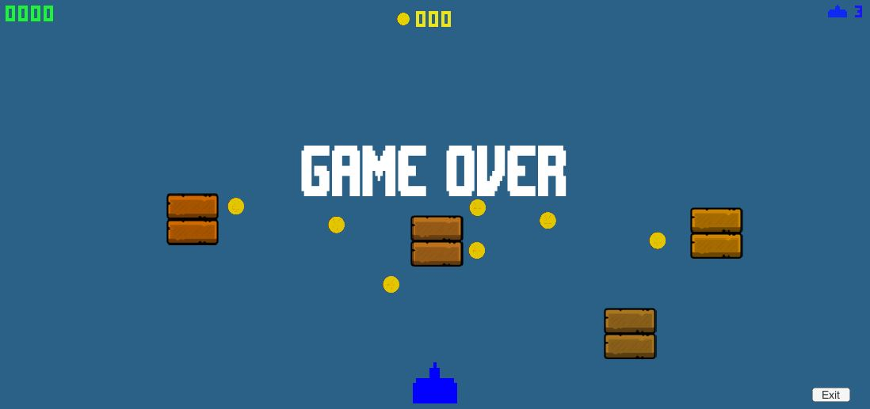
Stealth Strider
Amirhameed Amirjalali
Duha Alkurdi
Matthew Bryce
Shiva Rasouli

Slide 2
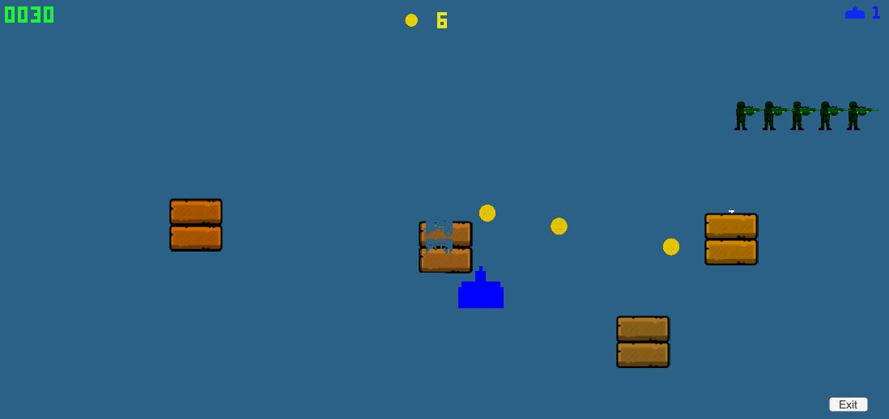
Welcome to Stealth Strider – Choose Your Path!
Stealth Strider challenges players to sneak, fight, or strategize through enemy territory while collecting valuable coins and reaching their destination.

Slide 3
Game Genre and Core Idea
Genre:
2D platformer with stealth and obstacle-avoidance mechanics.
Core Idea:
Players navigate maze-like levels, collecting coins and avoiding or defeating enemies.
Each level offers multiple ways to complete it, giving players the freedom to explore different paths and strategies.

Slide 4
Story and Setting
Story/Plot:
"Navigate the Room, Avoid or Confront Enemies, and Reach the Exit!“
You are the player, trapped in a room with patrolling enemies.
Your goal: Make it to the exit alive.
Strategy: You can sneak past enemies or shoot your way through—but be careful, one wrong move could be your last!
Victory: Reach the end of the room without getting shot!

Slide 5
Gameplay Mechanics
Core Gameplay Mechanics
Stealth or Combat: Players can sneak past enemies or fight them head-on.
Coin Collection: Collect coins scattered throughout the level to increase your score and progress to the next area.
Multiple Paths: Each level allows for different solutions—choose the path that fits your playstyle.
Additional Mechanics
Moving platforms, switches, and obstacles make navigation more challenging.

Slide 6
Unique Selling Points
What Makes Stealth Strider Unique?
Choice-Based Play: Players can decide whether to use stealth or combat in each scenario.
Non-linear Levels: Multiple ways to finish a level encourage experimentation and replay ability.

Slide 7
Target Audience
Who Will Enjoy Playing Stealth Strider?
Indie game fans who enjoy platformers and puzzle-based gameplay.
Gamers who like stealth mechanics (e.g., Mark of the Ninja, Metal Gear Solid).
Players who enjoy choice-based challenges and the ability to solve puzzles in multiple ways.

Slide 8
Art Style and Aesthetics
Visual Design: Minimalist pixel art combined with clean layouts.
Aesthetic: Bright colors with high contrast to distinguish platforms and obstacles.
Animation Style: Smooth movement for characters, with small visual cues (like light footsteps or visual sounds) to enhance stealth mechanics.

Slide 9
Level Design
Level Structure:
Levels feature multiple paths—some faster but riskier, others safer but slower.
Enemy Behavior: Patrol routes change dynamically, forcing players to adapt.
Coin System: Collecting coins opens new areas or grants special abilities (e.g., temporary invisibility).

Slide 10
Development Specifications
Hardware:
Development Machines:
Standard desktop/laptop with 8+ GB RAM, Quad-core CPU, and GPU for smooth Unity performance (e.g., NVIDIA GTX 1650 or equivalent).
Testing devices: Windows machine for desktop and laptop gameplay.
Software:
Game Engine: Unity 2023
Programming Language: C#
Version Control: GitHub or Git for collaboration and tracking progress.
IDE: Visual Studio or Rider for writing and debugging C# code.
Graphics Tools: Photoshop/GIMP for 2D sprites and textures.

Slide 11
Are you ready??
Will you sneak past the guards or fight your way to freedom? The choice is yours!
Try the prototype today! And be part of our journey

